Slide 1

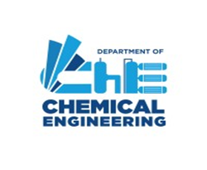
Synthesis of Microspheres for Controlled Release Applications
BTP-1 Mid -Sem
Supervisor:
Dr. Yogesh M. Nimdeo
Assistant Professor
Dept.of Chemical Engineering
Presented By:
Mr. Praval Kumar
2021UCH0025
Dept.of Chemical Engineering

Slide 2
Outline:
Aim Background Introduction Objective
Future Plan Advantages of Process Literature review
l

Slide 3
Aim:
To develop a stable chitosan-starch matrix for controlled release applications
To encapsulate NPK fertilizers within a suitable matrix to ensure controlled and sustained release of nutrients
To develop a method for synthesizing microspheres suitable for controlled release applications.
To optimize the particle size and structure for enhanced release control.

Slide 4
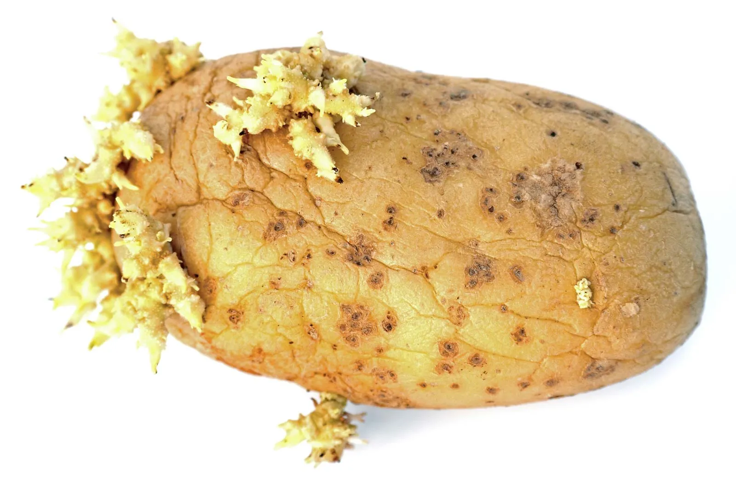
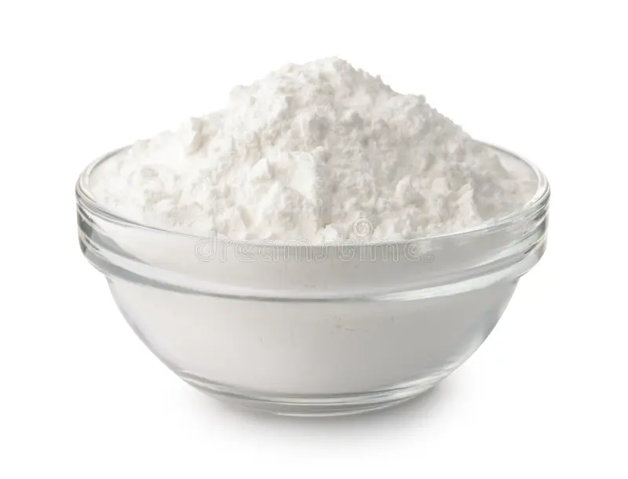
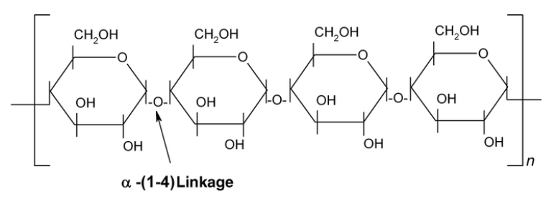
Background:
Starch is extracted from starch-bearing plants,such as potatoes.
Starch is the major component of potato tubers,amounting to approximately 15-20% of its weight.
In the potato tuber, starch is found as distinct granules approximately 10–100 μm in diameter ​
Fig:1sprouted potato tuber
Fig2:starch power
Tong, X., (2018). Evaluation of controlled release urea on nitrate and ammonium dynamics in black soils. Int. J. Environ. Res. Public Health,15(1), 119.

Slide 5
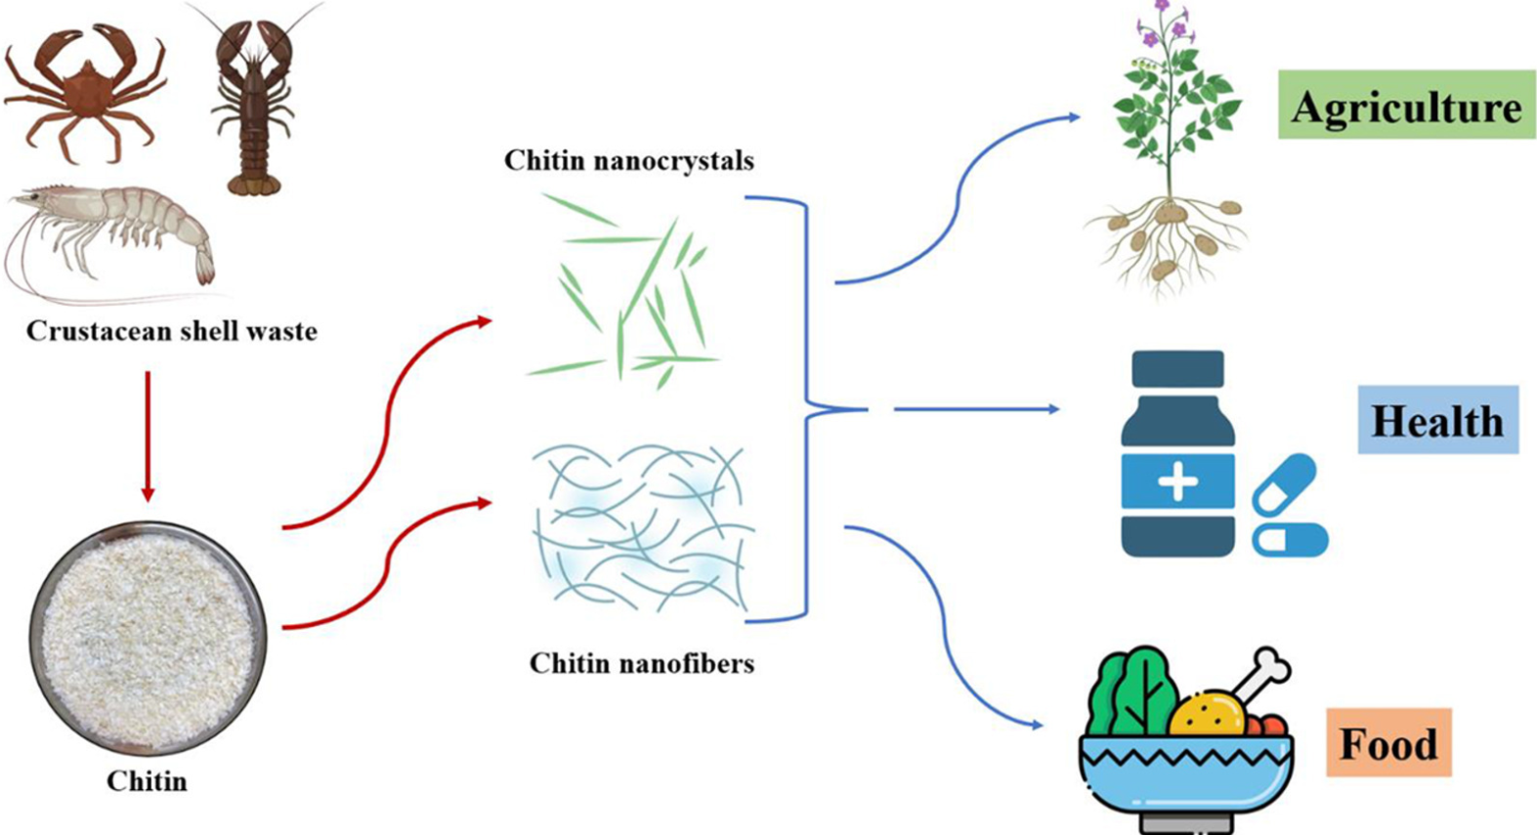
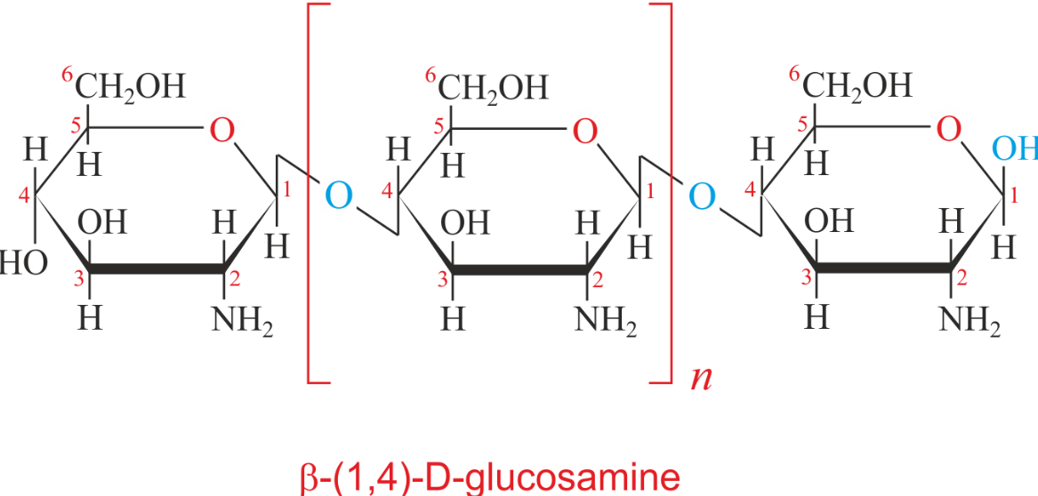
Continue…
Chitosan is obtained from the exoskeletons of marine animals, fungi and insects.
Chitosan is a biopolymer obtained from chitin, primarily extracted from shrimp shell waste.
Its biodegradability and antimicrobial properties make it valuable across industries like food processing, pharmaceuticals, and agriculture.
Fig1:chitosan extracted and uses
Tong, X., (2018). Evaluation of controlled release urea on nitrate and ammonium dynamics in black soils. Int. J. Environ. Res. Public Health,15(1), 119.

Slide 6
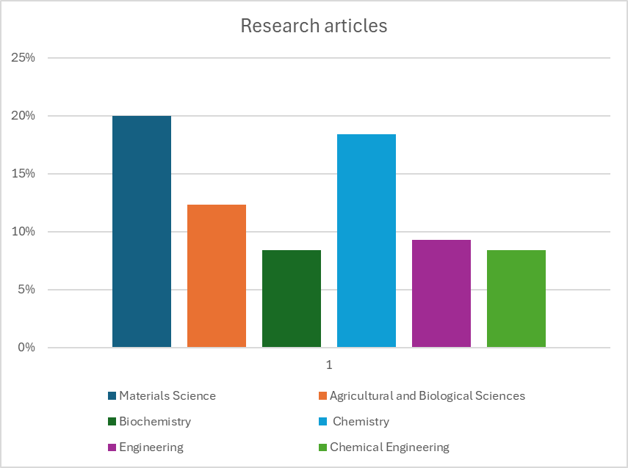
Continue…
Number of studies conducted on starch-chitosan blends, including various forms, such as films, beads, hydrogels, blends and composites, spanning the period from 2014 to 2023.
The 322 research articles are categorised into subject.
Materials Science: 20.0%
Chemistry: 18.4%
Agricultural and Biological Sciences: 12.3%
Engineering: 9.3%
Biochemistry: 8.4%
Chemical Engineering: 8.4%
Fig:Bar chart displaying the total number of publications and granted patents related to starch-chitosan blends
Tong, X., (2018). Evaluation of controlled release urea on nitrate and ammonium dynamics in black soils. Int. J. Environ. Res. Public Health,15(1), 119.

Slide 7
Introduction:
Urea, an important synthetic fertilizer, is widely used all over the world as the main source of plant nutrition
It is estimated that the percentage of the fertilizer dose recovered by the plants, when applied in conventional forms, may amount up to only 30-50%
The study of nitrogen usage in plants reported that only about 40-70% of the nitrogen in the fertilizer, can be absorbed by plants.
The unabsorbed nitrogen, which can range from 30-60%, is often lost to the environment through processes like leaching and volatilization, reducing fertilizer efficiency and increasing environmental risks such as soil degradation and water pollution.
Maharani, (2017). Effect of Zeolite-Chitosan Composites Coating on Urea Fertilizer as Slow Release Fertilizer. Research Journal of Pharmaceutical, Biological and Chemical Sciences, 8(6), 770-774. ISSN: 0975-8585.

Slide 8
Objective:
To determine the encapsulation efficiency of NPK in the blend, targeting maximum nutrient retention.
To study the release kinetics of NPK, focusing on sustained, controlled nutrient delivery under real-world conditions.
To optimize the encapsulation process for better performance in nutrient stability, cost, and scalability.
To evaluate the impact of encapsulation on nutrient bioavailability and plant uptake over time.

Slide 9
Literature review:
Author | Aim | Procedure | Remarks | Efficiency of the Process | Ref
Xin Tong | Evaluate the impact of controlled release urea on nitrate and ammonium in black soils | Buried bag method used to measure nitrogen release in soils over 35 days. | CRU reduced nitrate and ammonium levels, with polyurethane-coated urea performing good | CRU decreased nitrate levels by approximately 30% and ammonium levels by about 25% compared to conventional urea | 1
Dina Kartika Maharani | Test zeolite-chitosan coating for slow-release urea fertilizer | Coated urea with zeolite-chitosan (7:3 ratio), measured nitrogen release over 35 days | Higher zeolite slowed nitrogen release, improving fertilizer efficiency | Nitrogen release was reduced by approximately 40% compared to uncoated urea | 2
Amanda S. Giroto | Study the role of nanocomposite fertilizers on N and P availability in soil. | Nanocomposites of urea (Ur) and thermoplastic starch/urea (TP SUr) with hydroxyapatite (Hap) were produced. Release tests and incubation studies were conducted. | Enhanced nutrient control, reduced NH₃ loss, increased phosphorus availability | TP SUr/Hap20 showed 45.6% N volatilization; TP SUr/Hap50 had only 1% N volatilization after 7 days. | 3
Gelton G. F. Guimarães | Compare urease inhibitor and oxidized charcoal for urea-N conservation. | Urea-based composites were compared using different inhibitors and conditions in soil incubation experiments. | Found that unamended urea had higher NH3 volatilization compared to urease inhibitors, resulting in high N losses. | Urea alone resulted in over 50% N loss through volatilization. | 4

Slide 10
Continue…
Author | Aim | Procedure | Remarks | Efficiency of the Process | Ref
Amanda | To improve nitrogen and phosphorus release in soil using nanocomposite fertilizers | Produced nanocomposites with urea and hydroxyapatite, tested nutrient release and soil incubation. | Enhanced nutrient control, reduced NH₃ loss, increased phosphorus availability​ | Nitrogen release improved by approximately 35%, phosphorus availability increased by 50% | 5
Heba M. M. Abdel-Aziz | Compare effects of nano-NPK fertilizers with bulk NPK on wheat growth. | Foliar application of NPK nanoparticles on wheat. | Nano-NPK significantly improved growth metrics and reduced the life cycle of wheat plants. | Grain yield increased by 101.85%, shoot length by 11.06%, life cycle reduced by 23.5%. | 6
E.Corradini | Incorporate NPK fertilizers into chitosan nanoparticles for controlled release | Synthesized nanoparticles, added N (20-500 ppm), P (10-60 ppm), K (20-400 ppm). | Nanoparticles showed stable interactions, ideal for controlled release in agriculture | Controlled release was achieved, with NPK retention rates around 85% after 30 days | 7
Jonas J. Perez | Develop chitosan-starch hydrogels for controlled fertilizer release. | Prepared chitosan-starch beads by ionotropic gelation, analyzed properties. | Effective for sustained fertilizer release, higher production cost. | Achieved controlled release of fertilizer with approximately 90% retention after 14 days | 8

Slide 11
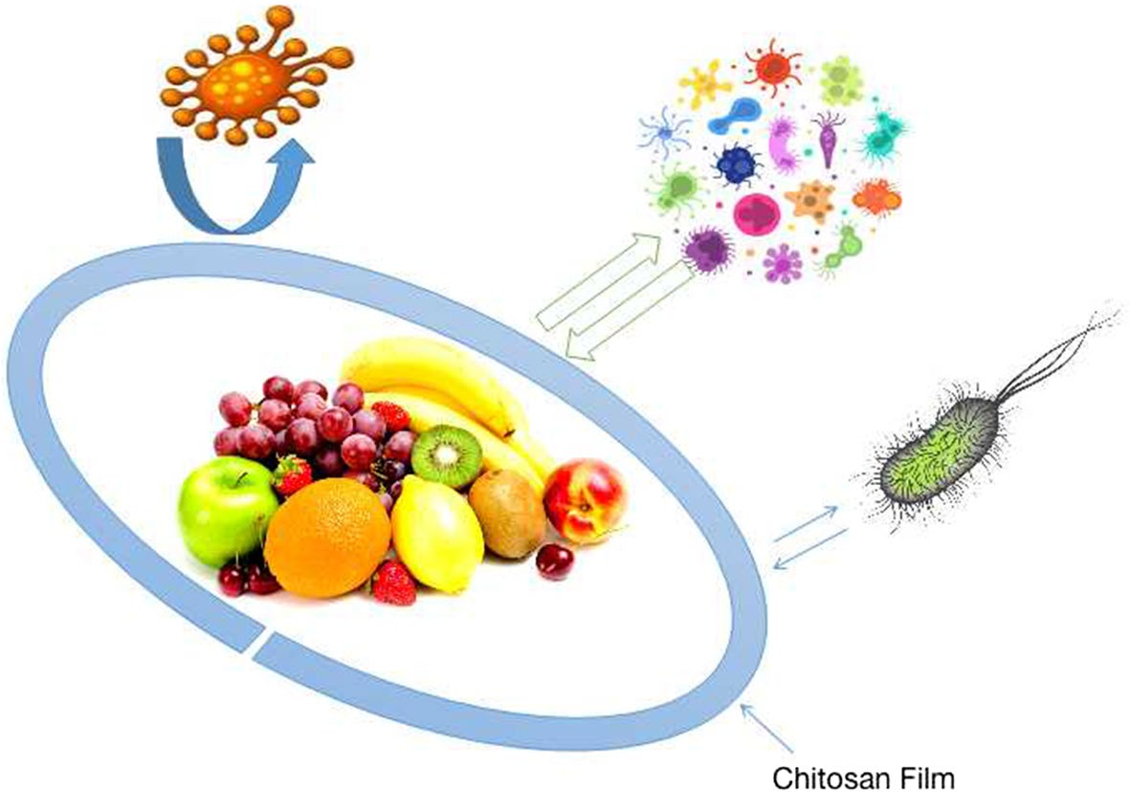
Advantages of Process:
CRU,particularly PCU ,effectively reduces nitrogen loss through leaching and gas emissions.
Offer a more environmentally friendly and efficient fertilizer option for black soils.
They enhance agricultural productivity through more efficient nitrogen management.
Chitosan and starch are biodegradable polysaccharides that offer low cost and non-polluting characteristics, making them suitable candidates for CRF development
Chitosan: a multipurpose polymer in food industry
Fig1:Edible film coating and food packaging
Shahbaz,. (2022). Chitosan: a multipurpose polymer in food industry. Journal of Food Science, (online publication). DOI: 10.1007/s11483-022-00408-9.

Slide 12
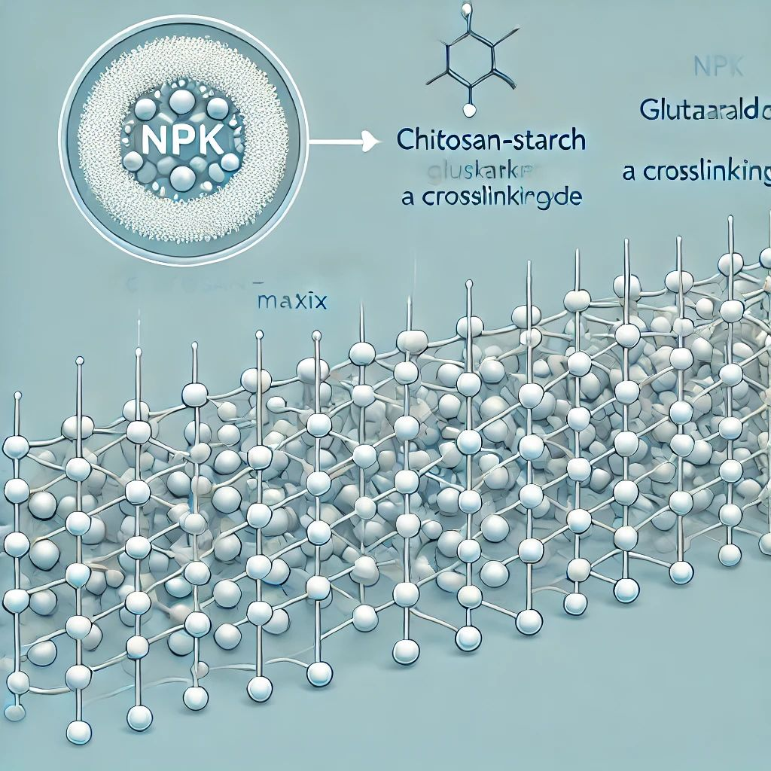
Future Plan:
Formation of chitosan-starch matrix using glutaraldehyde as crosslinking agent.
Encapsulation of NPK on the chitosan starch matrix beads.
Rheological analysis of synthesized microbeads.
Fig1:NPK into chitosan-starch and glutaraldehyde

Slide 13
References:
Tong, X., He, X., Han, L., & Huang, G. (2018). Evaluation of controlled release urea. Agronomy, 8(1), 1-12.
Maharani, D. K., & Novan, A. (2017). Effect of zeolite-chitosan coating on urea fertilizer. Research Journal of Pharmacy and Technology, Biological and Chemical Sciences, 8(2), 1624-1630.
Giroto, A. S., Guimarães, G. G. F., Foschini, M., & Ribeiro, C. (2017). Role of slow-release nanocomposite fertilizers on nitrogen and phosphate availability in soil. Scientific Reports, 7, 46032.
Abdel-Aziz, H. M. M., Hasaneen, M. N. A., & Omer, A. M. (2016). Nano chitosan-NPK fertilizer enhances wheat growth. Spanish Journal of Agricultural Research, 14(1), e0902.
Corradini, E., de Moura, M. R., & Mattoso, L. H. C. (2010). Incorporation of NPK fertilizer into chitosan nanoparticles. Express Polymer Letters, 4(8), 509-515.
Jainudin, R. S. D., Lestari, I., Kustiningsih, D., Irawanto, R., Bahaudin, R. L. A., Wardana, F., Muhammad, & Suyuti, M. (2018). Chitosan microspheres for urea release. IOP Conference Series: Materials Science and Engineering, 434(1), 012162.

Slide 14

https://slidechef.net/templates/thank-you-farmers-template-free/#google_vignette

